Slide 1
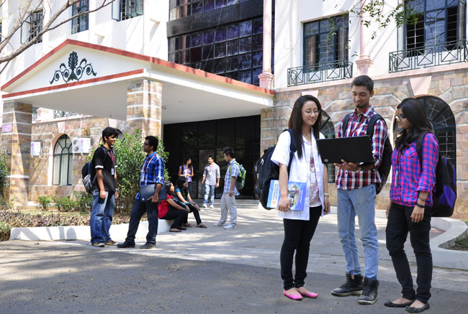

B.Tech Computer Science and Engineering – Vth Semester
Theory of Computation
Department of Computer Science and Engineering

Slide 2
Normal Forms of CFG
Chomsky Normal Form
The goal is to convert all the CFG of the form A->BC or A->a
Here A,B,C are Variables and ‘a’ is a terminal.
Approach
eliminate useless symbols.
eliminate ε productions.
Eliminate unit productions A->B for variables A->B.

Slide 3
Eliminate Useless Symbol
We say X is a useful symbol for any CFG=(V,T,P,S) if there is some derivation of the form S->*αXβ->*w.
where w is a string of terminals
X can be a Terminal or a Variable.
αXβ can be a first or last sentential form in the process of derivation.
We say X is generating if X->*w for some terminal string w. note that every terminal is generating, since w can be that terminal itself which is derived by 0 steps.
We say X is reachable if there is a derivation S->* αXβ for some α and β.

Slide 4
The example
S->AB|a
A->b
Here B is not generating.
If we eliminate the production which involves B then the grammar will be
S->a
A->b
but here A is not reachable from the starting symbol S.

Slide 5
Eliminating Useless Symbols
Reachable Symbols
Unreachable symbols
S->AB|a
A->b
Compute the reachable symbols

Slide 6
Eliminating ε productions
L-> ε
L->* ε
Consider the CGF
B->CAD
A-> ε
Here A is nullable
S->AB
A->aAA| ε
B->bBB| ε
----------------------------------------
S-> AB|A|B
A-> aAA|aA|a
B->bBB|bB|b

Slide 7
Eliminating Unit productions
Any production of the form
A-> B
I->a|b|Ia|Ib|I0|I1
F->I|(E)
T->F|T*F
E->T|E+T
The Grammar has to be re written.

Slide 8
Eliminating Unit productions
The normal Grammar with unit
production
E->E+T
E->T
T->T*F
T->F
F->(E)
F->I
I->a
I->b
I->Ia
I->Ib
I->I0
I->I1
E->E+T
E->T*F
E->F --- this is a unit production and has to be removed
So we rewrite two more productions
E->(E)
E->I --- this is a unit production and has to be removed
So we rewrite two more productions
E->a|b|Ia|Ib|I0|I1

Slide 9
Eliminating Unit productions
T->T*F
T->F --- this is a unit production so we have added the following two productions
T->(E)
T->I --- this is a unit production so we have added the following two productions
T-> a|b|Ia|Ib|I0|I1
F->(E)
F-> I -- this is a unit production so replace I with all of its derivations.
F->a|b|Ia|Ib|I0|I1
I->a|b|Ia|Ib|I0|I1

Slide 10
The Resultant Grammar will be
E->E+T|T*F|(E)|a|b|Ia|Ib|I0|I1
T->T*F|(E)|a|b|Ia|Ib|I0|I1
F->(E)|a|b|Ia|Ib|I0|I1
I->a|b|Ia|Ib|I0|I1

Slide 11
Chomsky Normal Form – CNF
In CNF all productions should be of the format
A->BC
Here A, B, C are Variables
Or
A->a
here A is a variable and ‘a’ is a terminal.
One relaxation is we can have productions of the format A->BCD (three symbols on RHS)

Slide 12
Now let us try to convert the Grammar into Chomsky Normal Form.
E->(E) – this is not CNF
E->LER
L->(
R->)
E->Ia - not a CNF
E->IA
A->a
E->Ib- not a CNF
E->IB
B->b
E->I0
E-IZ
Z->0
E->I1
E->IO
O->1
E->E+T|T*F|(E)|a|b|Ia|Ib|I0|I1
T->T*F|(E)|a|b|Ia|Ib|I0|I1
F->(E)|a|b|Ia|Ib|I0|I1
I->a|b|Ia|Ib|I0|I1
E->E+T -- this is not CNF because + is a terminal.
Introduce a new variable for ‘+’
E->EPT
P->+
E->T*F – this is not CNF
E->TMF
M-> *

Slide 13
Converting the Grammar into Chomsky Normal Form.
T->T*F – not a CNF
T->TMF
M->*- This production is already available so need not be added newly.
T->(E) - not a CNF
T->LER
T->a
T->b
T->Ia not a CNF
T->IA
T->Ib not a CNF
T->IB
T->I0 not a CNF
T->IZ
T->I1 not a CNF
T->IO
F->(E) not a CNF
F->LER
F->Ia not a CNF
F->IA
F->Ib not a CNF
F->IB
F->I0 not a CNF
F->IZ
F->I1 not a CNF
F->IO
I->Ia not a CNF
I->IA
I->Ib not a CNF
I->IB
I->I0 not a CNF
I->IZ
I->I1 not a CNF
I->IO

